Slide 1


Python programming
Hello world!
Notes:
Let’s dive in to our first Python program.

Slide 2
The “Hello, WORLD!” program
Your first program
It is a tradition in programming language reference manuals to introduce the language with an example that displays the text
“hello, world!”
So let’s have a go….
Notes:
It is a tradition in programming language reference manuals to introduce the language with an example that displays the text
“hello, world!”
So let’s have a go….
2

Slide 3
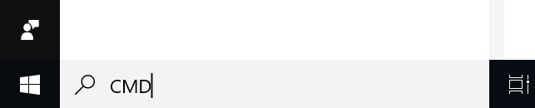
The “Hello, WORLD!” program
Launch Python in “interactive” mode.
On Windows computers enter CMD in search.
(Mac is different – use Terminal)
Notes:
The first thing we need to do is start Python. To do this we use the Windows Command Prompt.
3

Slide 4
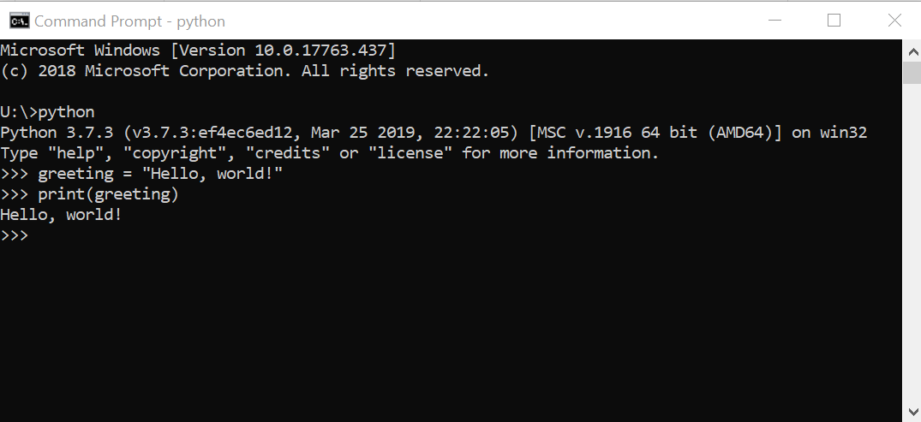
The “Hello, WORLD!” program
Launch Python in “interactive” mode
Type - python
Notes:
4

Slide 5
The “Hello, WORLD!” program
greeting = "Hello, world!“
print(greeting)
Notes:
Now enter this text at the prompt.
5

Slide 6
The “Hello, WORLD!” program
Line by line
greeting = "Hello, world!"
The word greeting is a variable
The = symbol represents assignment
The text "Hello, world!" is a string literal
Notes:
6

Slide 7
The “Hello, WORLD!” program
Line by line
print(greeting)
The style some_name( ) represents a named function, in this case the print function
The print function prints its arguments, or parameters
Notes:
7

Slide 8
The “Hello, WORLD!” program
Line by line
Hello, world!
This is the result of running the program text. Note that the text is not quoted. The quotation marks around the string literal are what let Python know it’s a string.
Notes:
8

Slide 9
The “Hello, WORLD!” program
Running a Python script (program)
08/06/2019 15:34 <DIR> .
07/06/2019 14:35 <DIR> ..
08/06/2019 18:44 45 hello.py
1 File(s) 45 bytes
2 Dir(s) 365,085,536,256 bytes free
U:\mypython>python hello.py
Hello, world!
U:\mypython>
Notes:
9

Slide 10
The “Hello, WORLD!” program
Using the editor
U:\mypython>dir
Volume in drive U is Offline
Volume Serial Number is 0000-0000
Directory of U:\mypython
08/06/2019 15:34 <DIR> .
07/06/2019 14:35 <DIR> ..
0 File(s) 0 bytes
2 Dir(s) 365,087,715,328 bytes free
U:\mypython> atom hello.py
Notes:
10

Slide 11
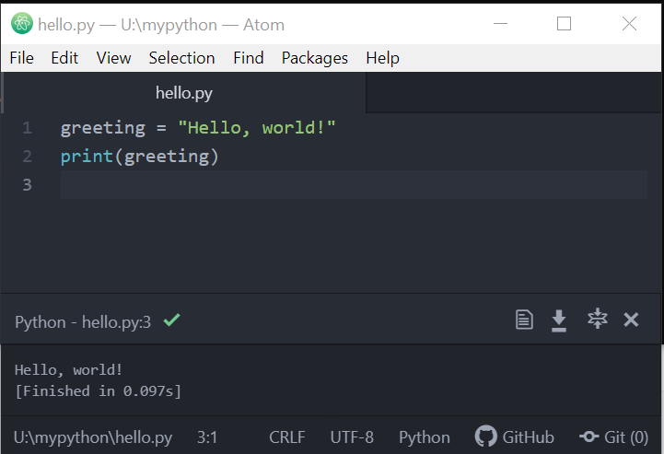
The “Hello, WORLD!” program
Creating the hello.py file
Notes:
11

